Slide 1

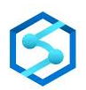

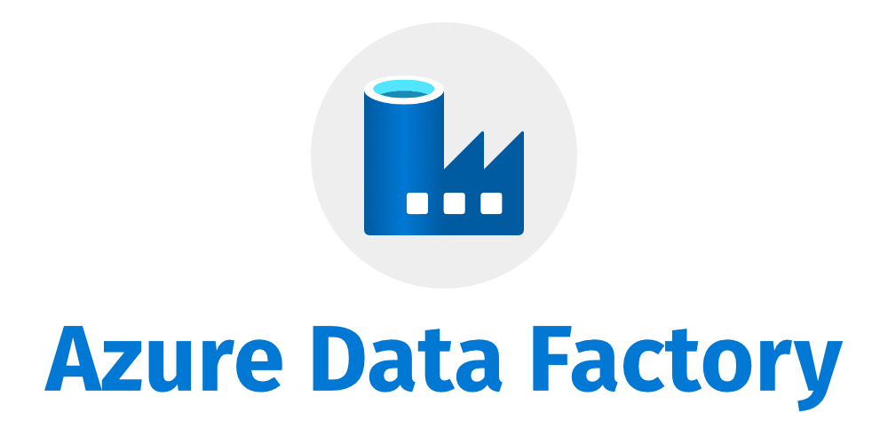
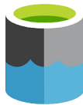
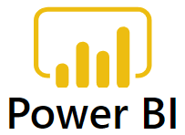
Data Source
Azure Data Factory
Azure Data Lake
Azure Databricks
Azure Data Lake
Azure Synapse Analytics
Power BI

